Slide 2
The Hope of Israel
Psalm 83, Romans 8

Slide 3
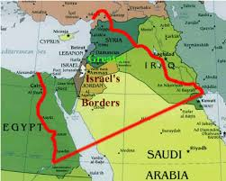

Slide 4
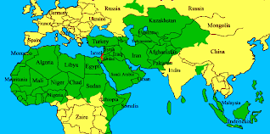

Slide 5
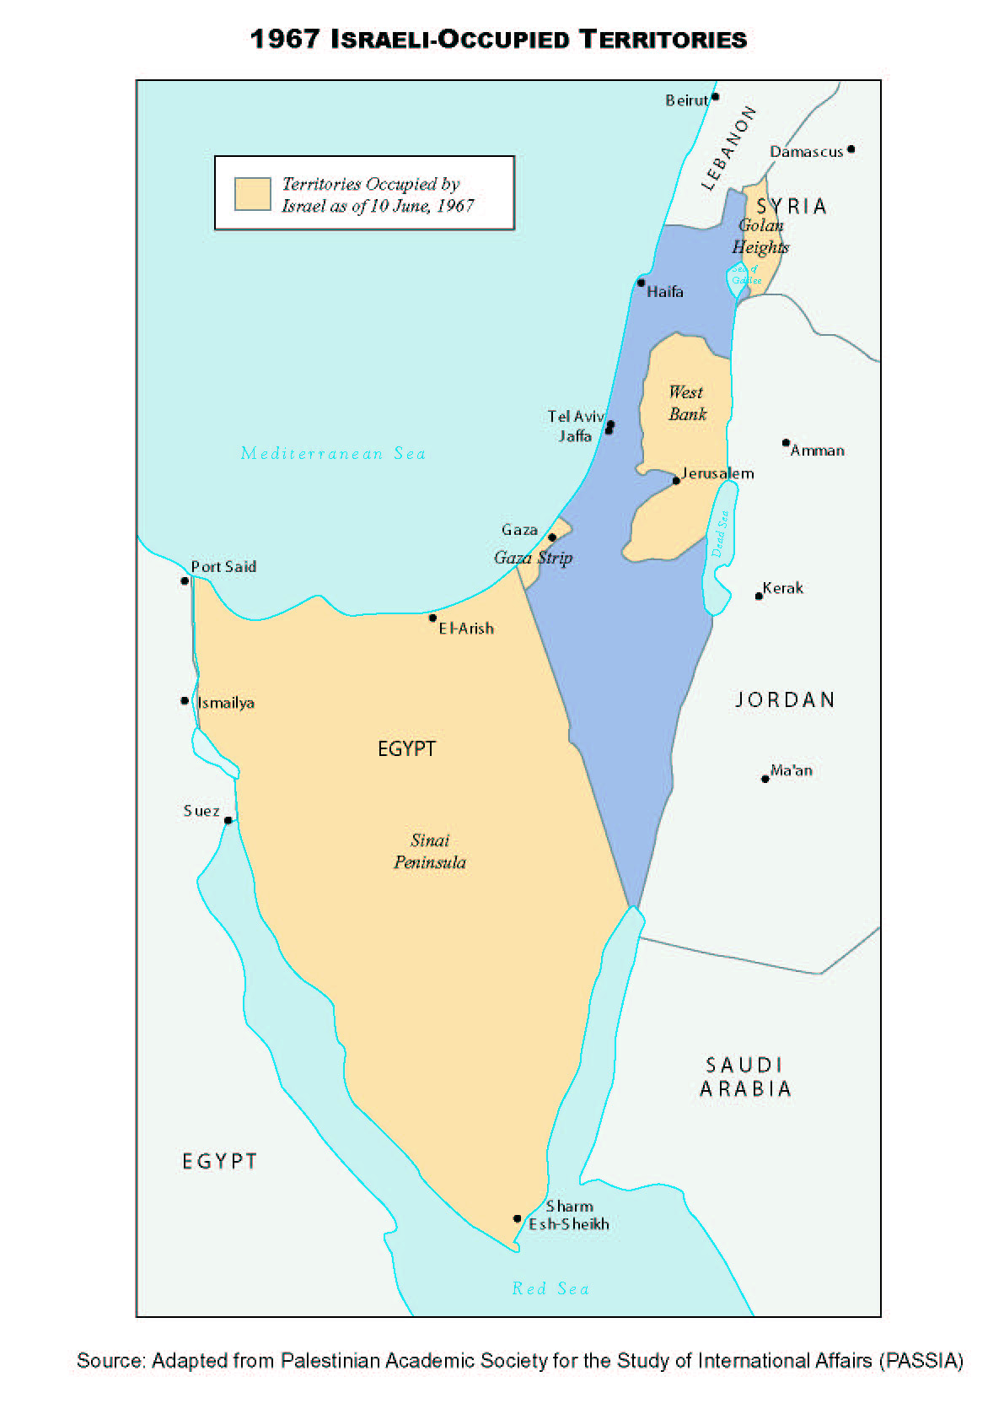

Slide 6
